Slide 1
CAPSTONE PROJECT -1
EXPLORATORY DATA ANALYSIS
(EDA)
ON
PLAY STORE APP REVIEW DATA
Team Members
Iqbal Babwane
Sameer Ansari
Lukman Haider
UNDER THE GUIDANCE OF TEAM ALMABETTER

Slide 2

CONTENT
INTRODUCTION
PROBLEM STATEMENT
DATA OVERVIEW
APP ENGAGEMENT & SUCCESS
EXPLORATORY DATA ANALYSIS
KEYPOINTS OF ANALYSIS

Slide 3
INTRODUCTION OF PLAYSTORE
Google Play Store is an online store for android applications
Safe, secure, and convenient
Their products available to over two billion people
Available in 190 countries
Games, movies, TV shows, books, and many more categories are available

Slide 4
PROBLEM STATEMENT
Play store is a huge market for android application, so we will perform exploratory data analysis for play store data to get some desired comments on play store such as –
MOST USED CATEGORY
TOP HIGHEST PROFITABLE APPS
HIGHEST NUMBER OF INSTALLS
From all such kind of point a developer is able to understand in which region they should work for highest return of investment

Slide 5

DATA OVERVIEW
Play Store Data
This data contains the property and characteristics of each apps
App
Category
Rating
Reviews
Size
Installs
Type
Price
Content rating
Genres
Last updated
Current ver
Android ver
User Reviews
This data includes reviews based on users personal experience, this can be converted in variable and can be used for analysis
Translated_Reviews
Sentiment
Sentiment_Polarity
Sentiment_subjectivity

Slide 6

EXPLORATORY DATA ANALYSIS

Slide 7
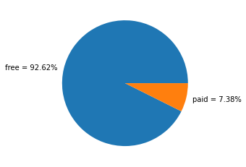
Percentage of free and paid app
Free apps are ruling the market by huge percentage that is 92.6%
Percentage of paid apps present in Play store is 7.4% which is very low.

Slide 8
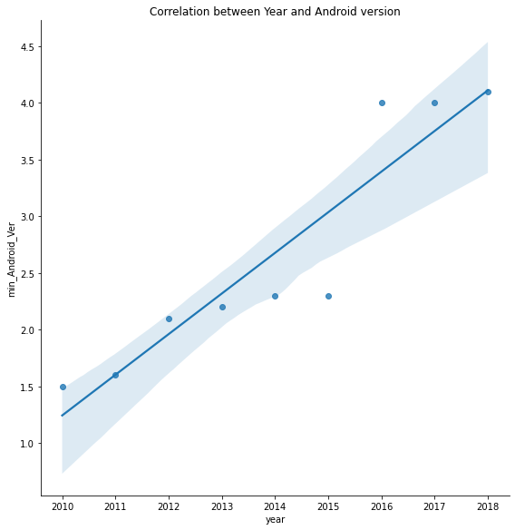
Correlation between year and android version
Since 2010 minimum android version has increased from 1.5 to 4.1,
hence it is positive type of correlation and will increase in future also.

Slide 9
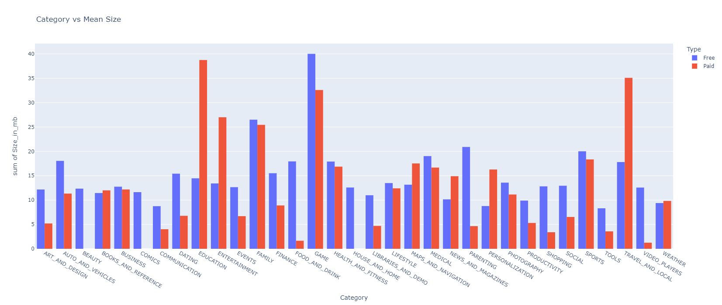
Category wise avg size of app
Free
Game
Family
Parenting
Paid
Education
Travel And Local
Game
Top 3 category highest in size

Slide 10
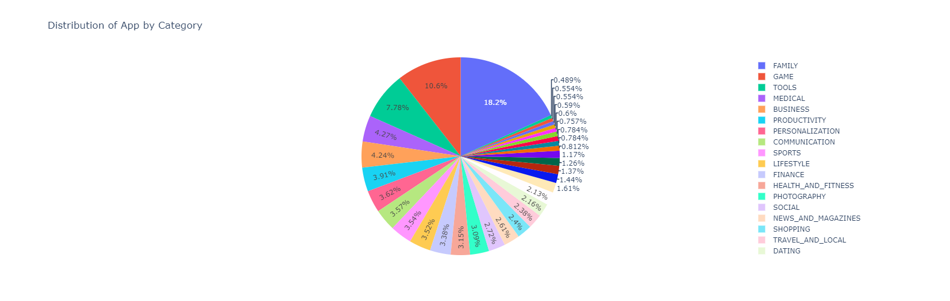
Distribution of App by Category
‘Family’ category has highest number of apps in play store i.e. 1971 apps (18.2%).
The category which has second highest number of apps present in play store is ‘Game’ and number is 1144 apps.
Lowest number of apps present in play store is ‘Beauty’ and the number is 53 apps.

Slide 11
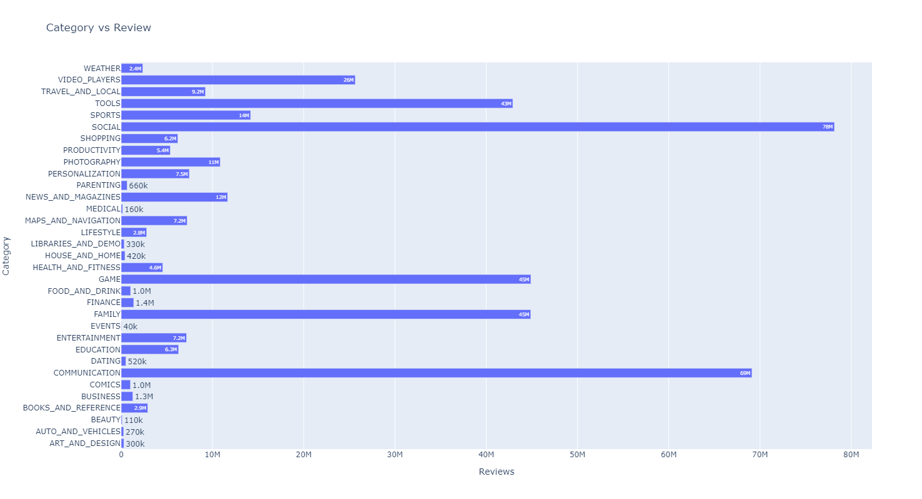
Most review apps category wise
The highest review of category is ‘Social’ and number of reviews is 78 million
The second highest review of category is ‘Communication’ and number of reviews is 69 million
The lowest review of category is ‘Events’ and number of reviews is 40 thousand.

Slide 12
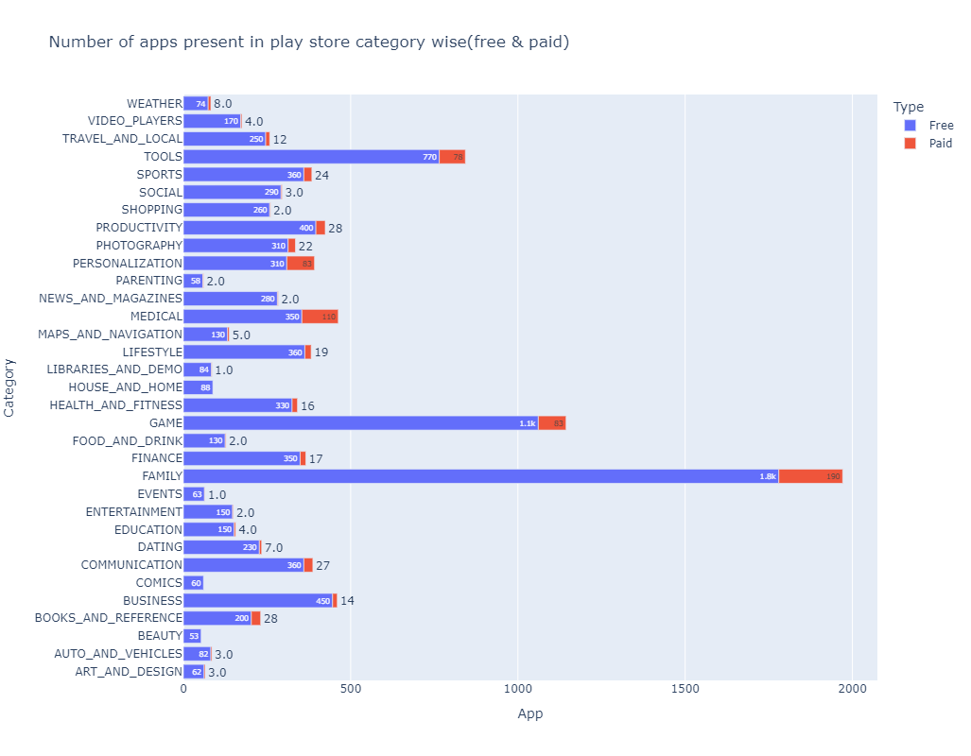
Number of apps present in play store category wise
The Family category takes the lead in both the section (free and paid)
In comics and beauty category, there is no any paid apps

Slide 13
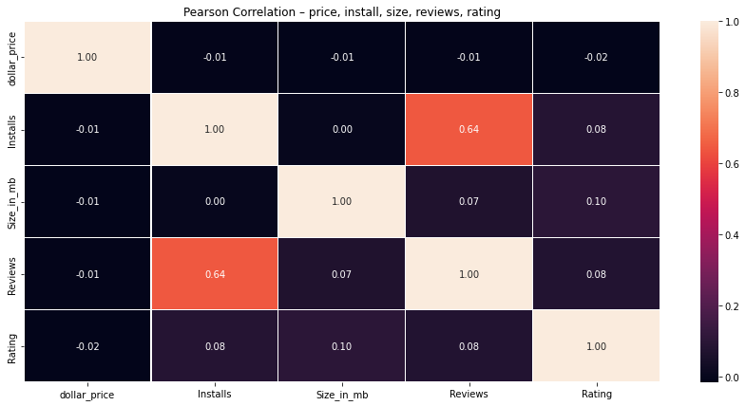
Pearson Correlation - price, install, size, reviews, rating
Correlation between Reviews and Installs is 0.64 and positively as well as strong correlated with each other.
Rating is slightly negative correlated with price

Slide 14
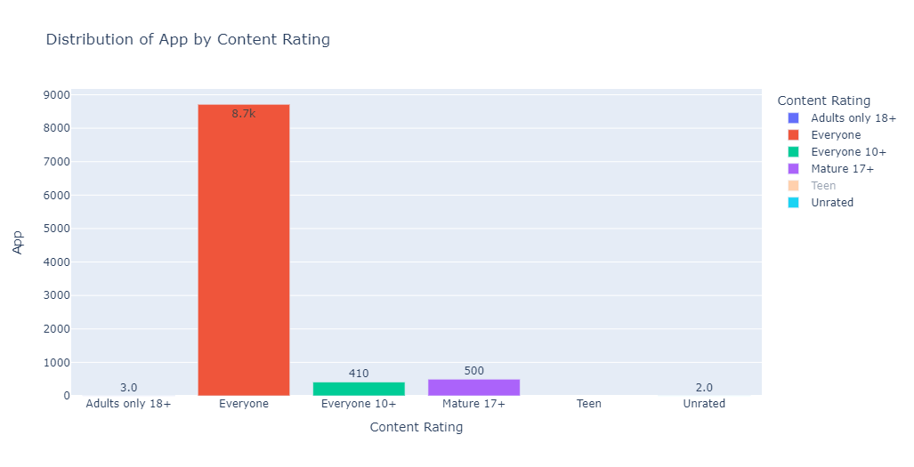
Distribution of App by Content Rating
‘Everyone’ content rating has highest number of apps, which is 8.7 thousand
Lowest apps is present in ‘Adult only 18+’ and ‘Unrated’.

Slide 15
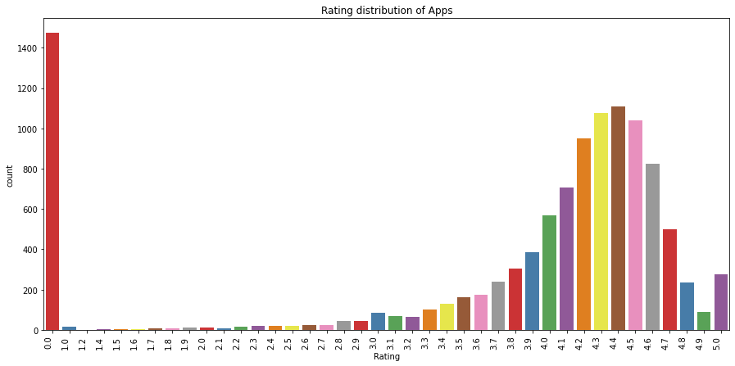
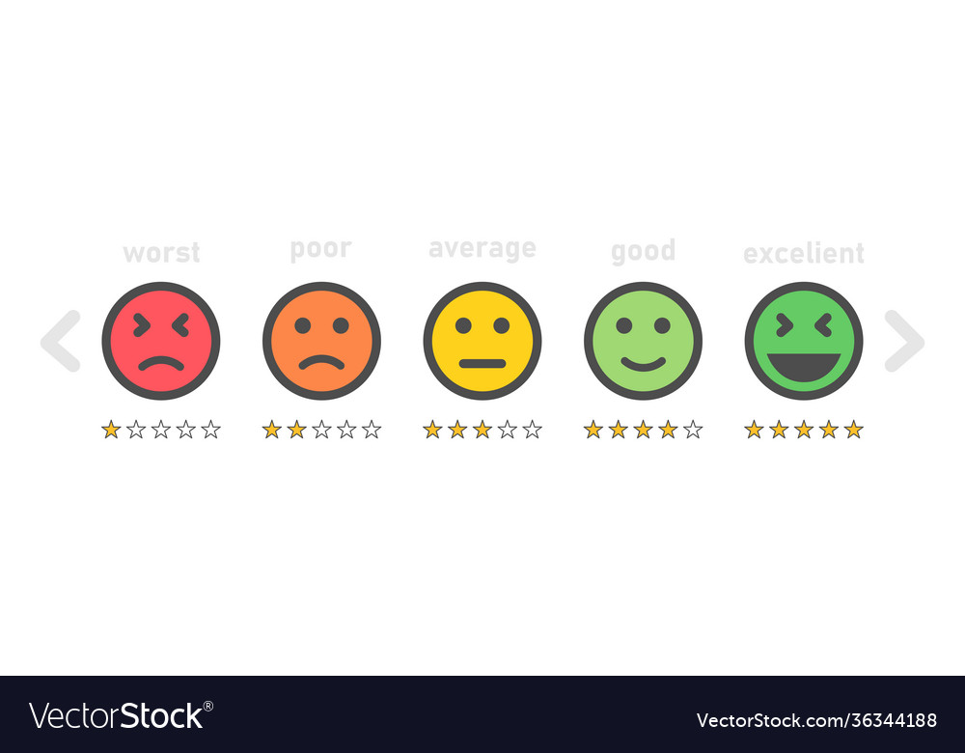
Rating distribution of apps
From observing chart, the average rating is between 4.0 to 4.7.
There are 265 application which have 5 star rating

Slide 16
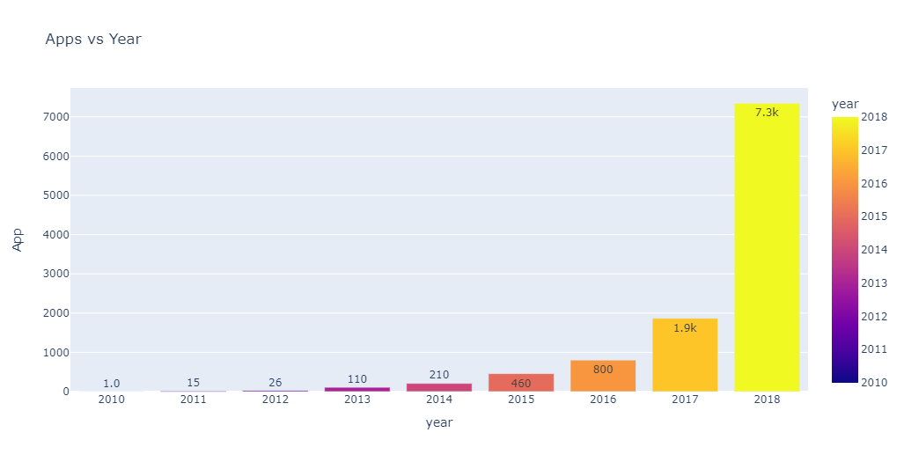
Variation of App released with respect to Year
Number of applications is increasing year by year
Since 2017 to 2018 number of applications is increased by 4 times.
We can also predict the number will be increase in future also

Slide 17
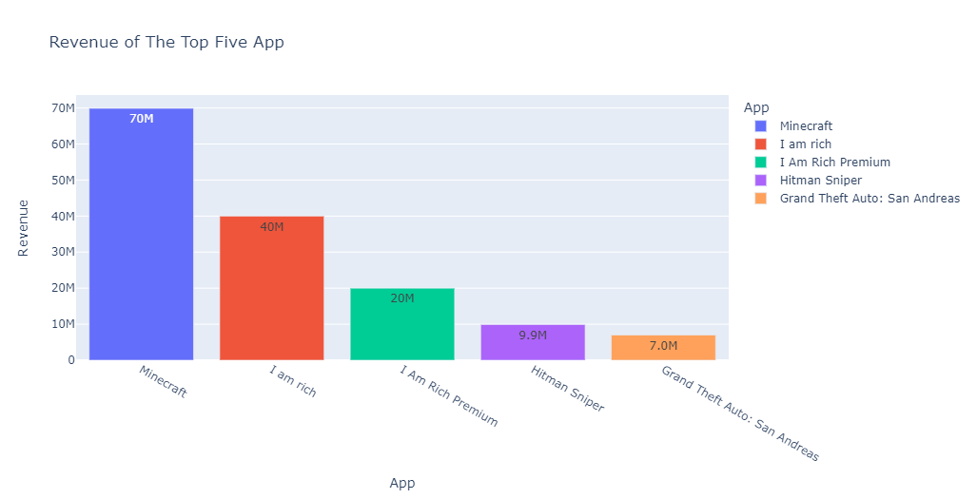
Top five Revenue App
The highest revenue application is ‘Minecraft’ and category is ‘Game’ with Revenue of 69900000 $

Slide 18
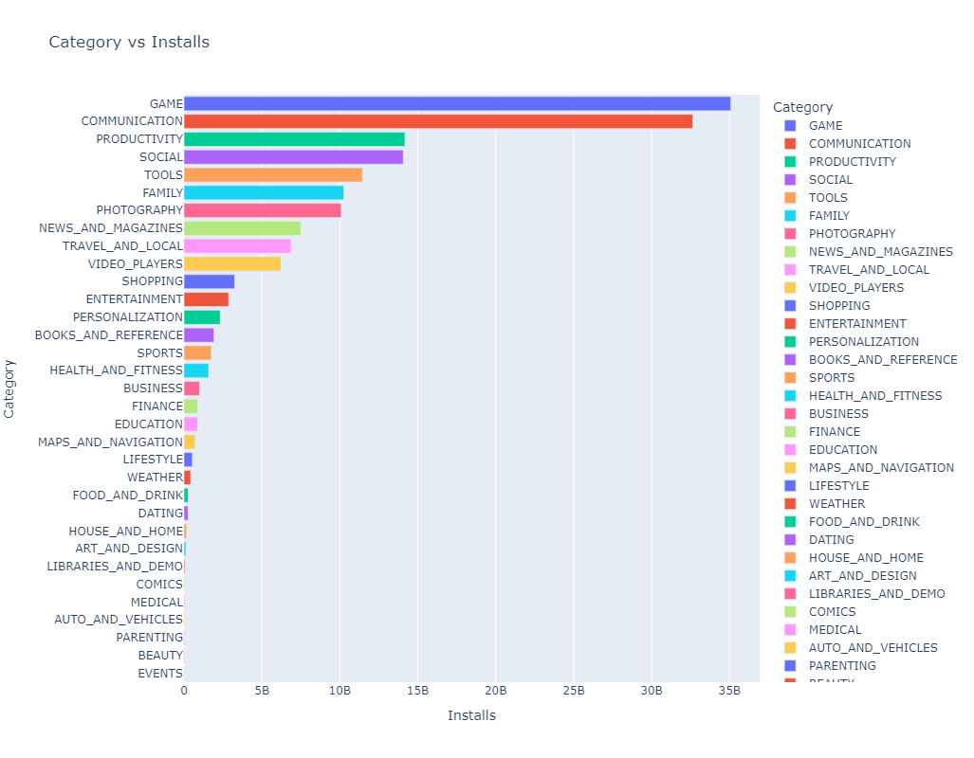
Distribution of Category by install
The ‘Game’ category has highest number of installs, which has approximate value is 35 billion installs.
The second highest category is ‘Communication’ i.e. 32.6 billions of installs
16 million installs is the lowest downloaded category which is ‘Event’.

Slide 19
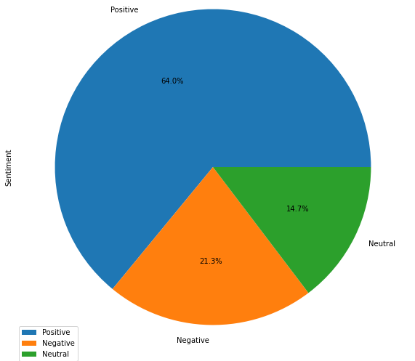
Percentage of Positive, negative and neutral reviews
64.0%
In play store, 64% user reviews is positive towards an application.
21.3% user reviews are negative towards an application and remaining 14.7% are neutral.
14.7%
21.3%

Slide 20
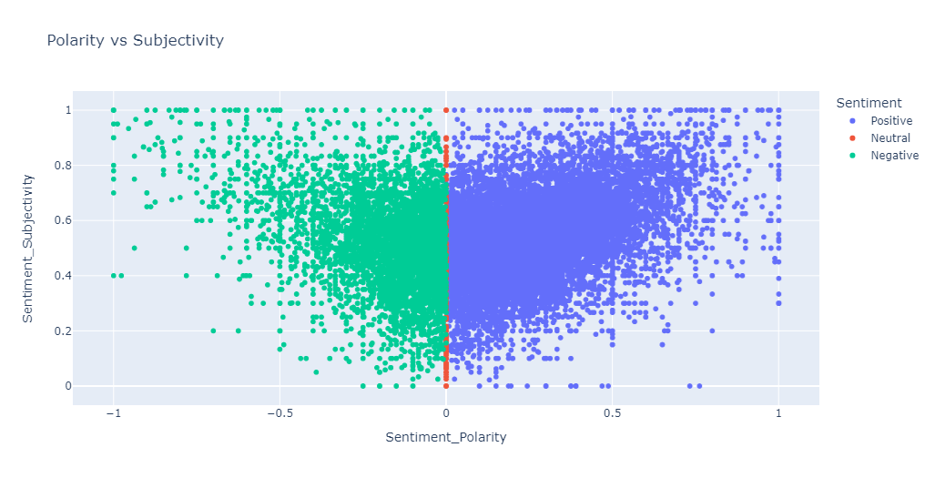
Sentiment Polarity vs Sentiment Subjectvity
When sentiment is positive, the value of sentiment polarity is positive and the value of sentiment subjectivity also positive.
When sentiment is negative, the value of sentiment polarity is negative and the value of sentiment subjectivity positive.
When sentiment is neutral, the value of sentiment polarity is zero and the value of sentiment subjectivity positive.

Slide 21
KEY POINTS OF ANALYSIS
92.62% applications are present in play store is free and only 7.38% paid applications
Android version required for the applications is increasing year by year.
The average size of the application for all categories is lies between 5 – 10MB.
18.2% of applications present in play store is from ‘Family’ category.
The applications which belonging ‘Social’ category are most reviewed applications.
Strong positive correlation in between reviews and installs.
‘Everyone’ content rating has highest number of apps, which is 8.7 thousand
The average rating of applications is in between 4.0 – 4.7.
Variation of releasing new apps in play store is high & will increase by a huge rate in future
Minecraft is highest revenue application in play store and the revenue is 69.9M
64% users are positive sentiment and 21% are negative sentiment.
‘Comics’, ‘Beauty’ and ‘House and home’ in this categories, only free applications are present.

Slide 22
App engagement and success
‘Family’, ‘Game’ and ‘Communication’ category are one which has given some success apps
Apps having ‘Everyone’ as content rating comes in majority among all
92% of users are interested in free apps. Its better to use inside – app purchase strategies.
‘Comics’, ‘Beauty’ and ‘House and home’ in this categories there is no any paid apps present. It will be better to target this categories by releasing paid apps.
Success App
Family, Game, Communication, Social
Free App
(use in-app purchase)
Make unique concept for Comics, Beauty and House and home and release paid apps here
‘Everyone’ as content rating

Slide 23


